Slide 1
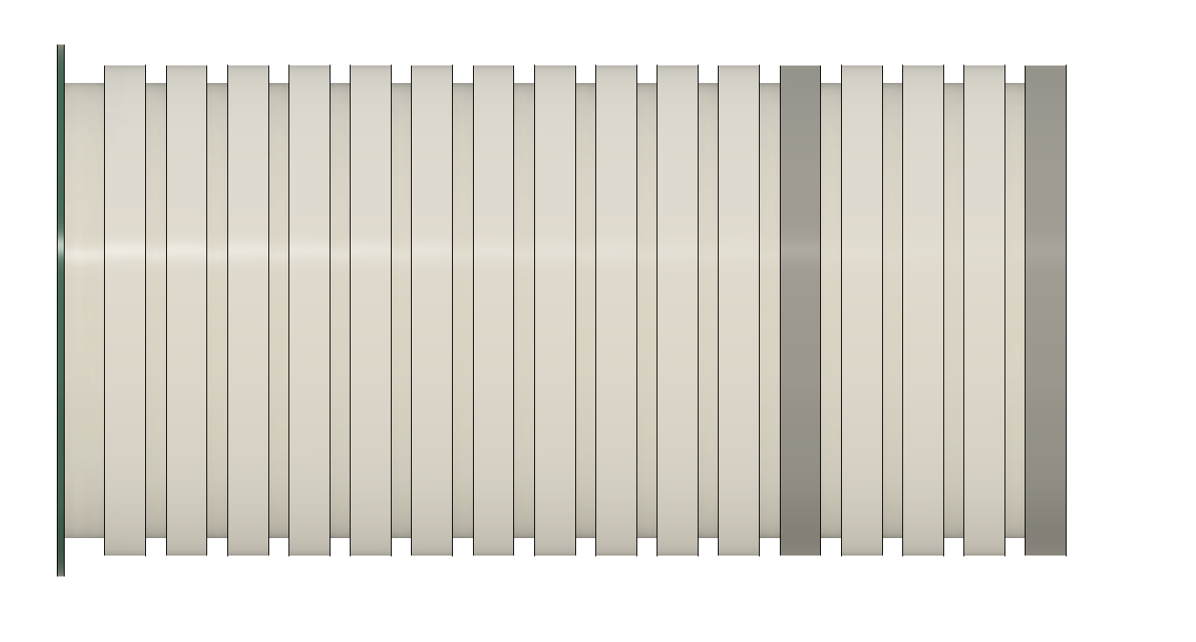
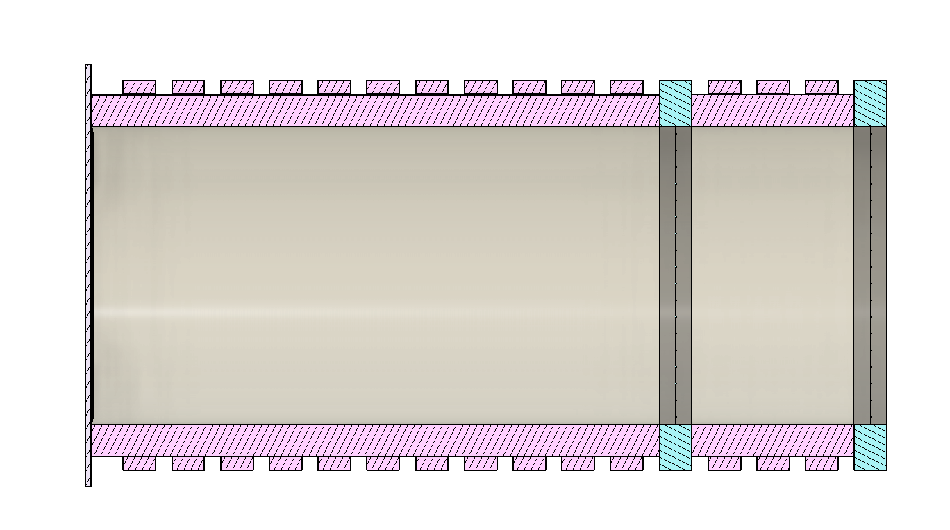
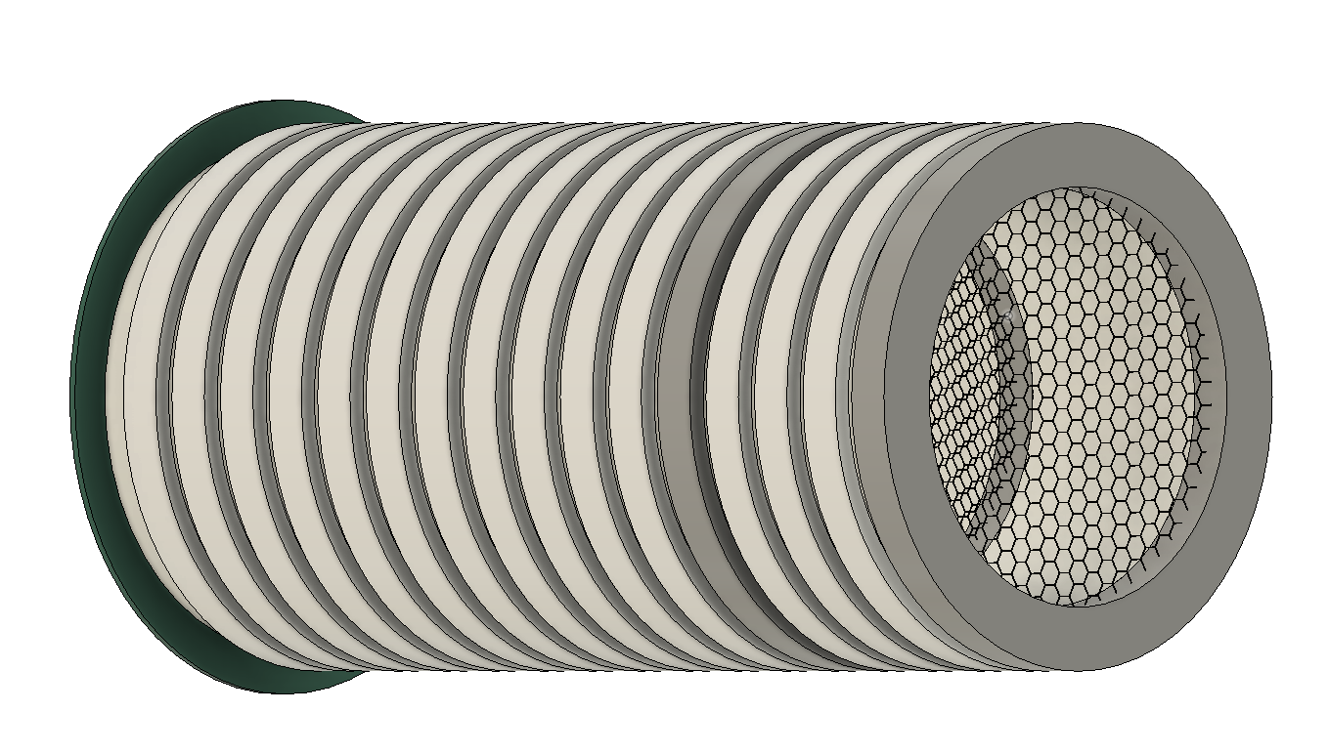
Side View
Cross Section Cut
Side Tilt View
A
B
C
D
E
F
A – Collection Plane B – Electron Field Rings C – Electron Drift Region D – High Density Polyethylene
E – Hexagon Mesh Grid Field Rings F – Buffer Region

Slide 2
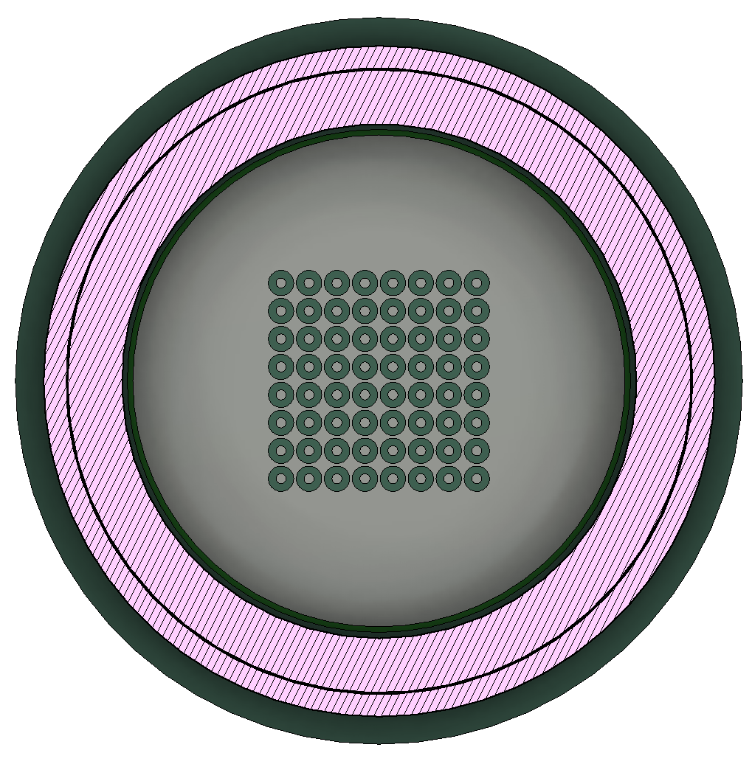
Pixel
Mesh Grid
HDPE
Field Cage Ring

Slide 3
TPC Regions of Interest for Simulation
Charge Drift Region
Buffer Region

Slide 4
TPC Field Configurations
Positive Voltage Bias
Negative Voltage Bias
V = 0
HV +
V = 0
V = 0
HV -
V = 0
Legend
Force on Positive Charges
Force on Negative Charges

Slide 5
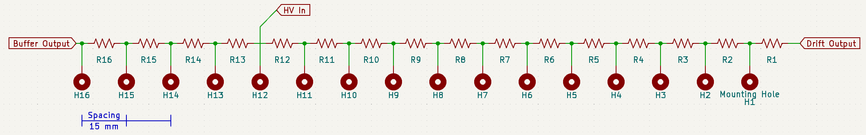
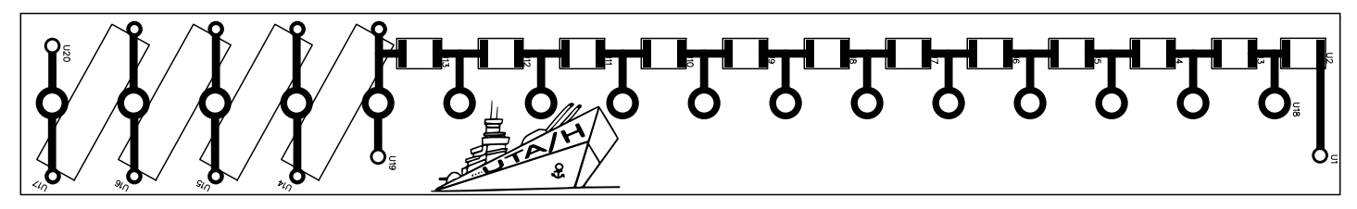










Cage Potential Circuit Diagram
2D Render of PCB Board
From Original Documentation
Static Field Cage Calculations
Variables
Currents
Voltage Drop per Resistor
Voltage Drop / mm
$R_{n}= R$ $n=1,2,3,…16$
$$I_{Buffer}=\frac{V}{(4∗R)}$$
$$V_{Buffer}=\frac{V_{Buffer}}{15}$$
$V_{Buffer}=I_{Drift} ∗R$
$${HV}_{in}=V$$
$$D_{out}=0$$
$$I_{Drift}=\frac{V}{(12∗R)}$$
$$V_{Drift}=\frac{V_{Buffer}}{15}$$
$$B_{out}=0$$
$V_{Drift}=I_{Drift} ∗R$

Slide 6
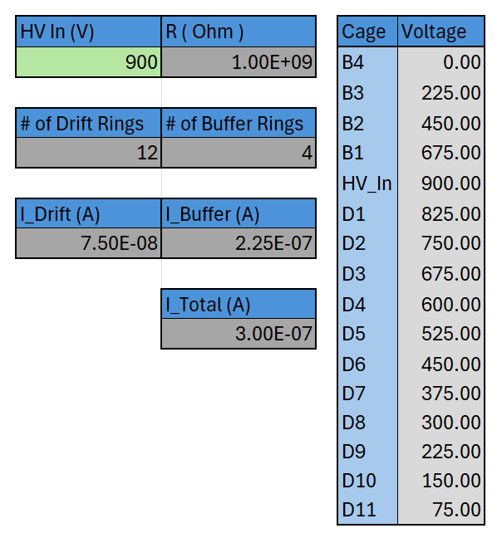
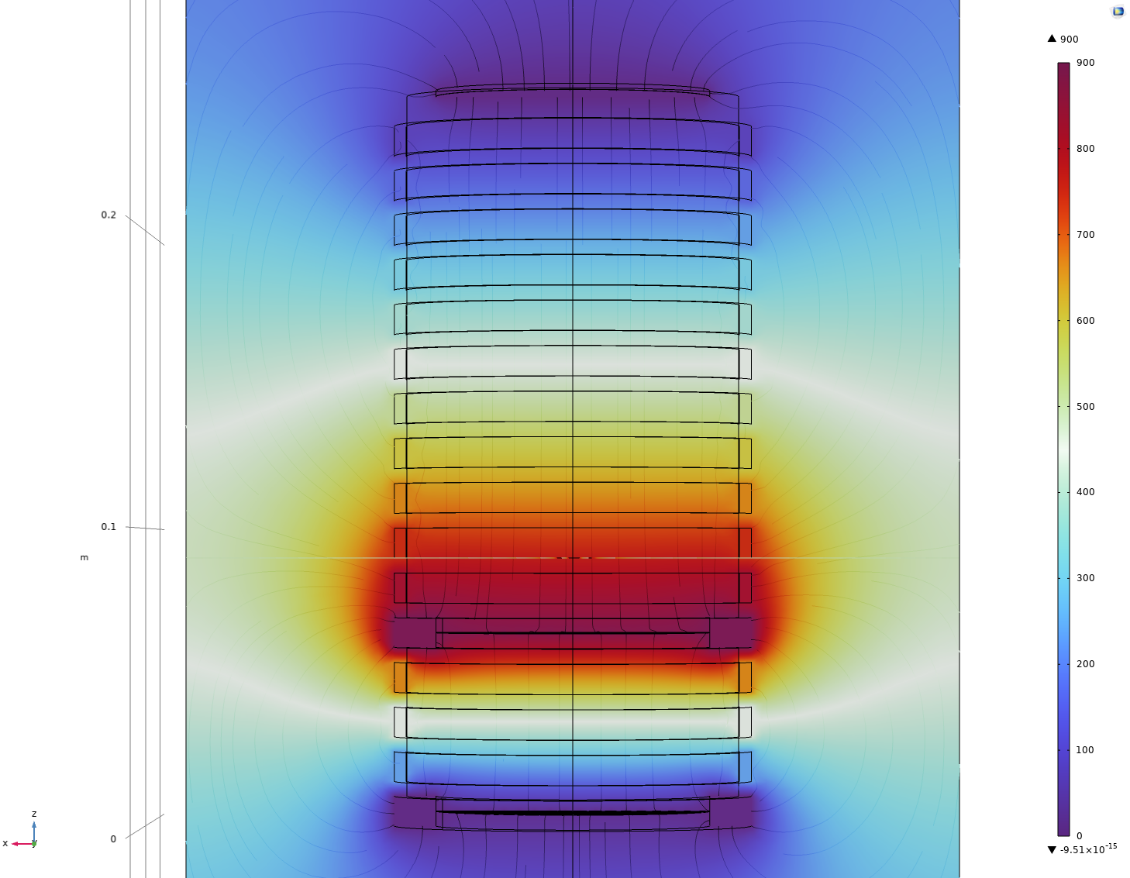
Excel Sheet Calculator
COMSOL Simulation
Expected Drift based on Simulation
B4
B3
B2
B1
HV
D1
D2
D3
D4
Changing the green box in the excel sheet will update all values. All other values are constant or set.
D5
D6
D7
D8
D9
D10
D11

